Slide 1
Lecture 9:Modem Hardware for Modulation and Demodulation
Requirements of data transmission over long distances:
modulator at one end and a demodulator at the other end
the modulator and demodulator are embedded into one device.
the process of modulation and demodulation done at both ends

Slide 2
most data communications systems are full duplex (duplex).
When the modulator and demodulator are combined, the name modem is used.
The figure below shows the hardware used for modulation and demodulation in a 4- wire data communication system.

Slide 3
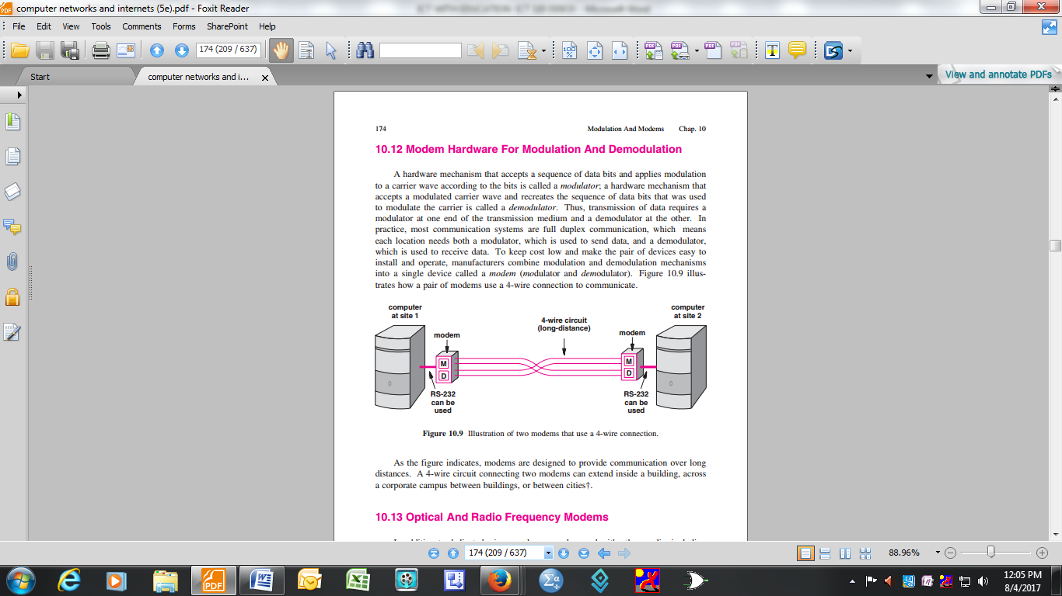
Figure 45: Modem hardware for modulation and demodulation

Slide 4
Operation
Data (series of data bits) from computer at site 1 is passed on to the modulator M.
Modulator transforms them into a suitable form for transmission over the 4-wire circuit.
Demodulator used in the computer at site 2 converts back the data signals to the original series of data bits.

Slide 5
Dialup Modem
A dial up modem uses an audio tone
Dial up modems are common in telecommunication systems.
This type of modem is usually embedded in a computer and is referred to as an internal modem.

Slide 6
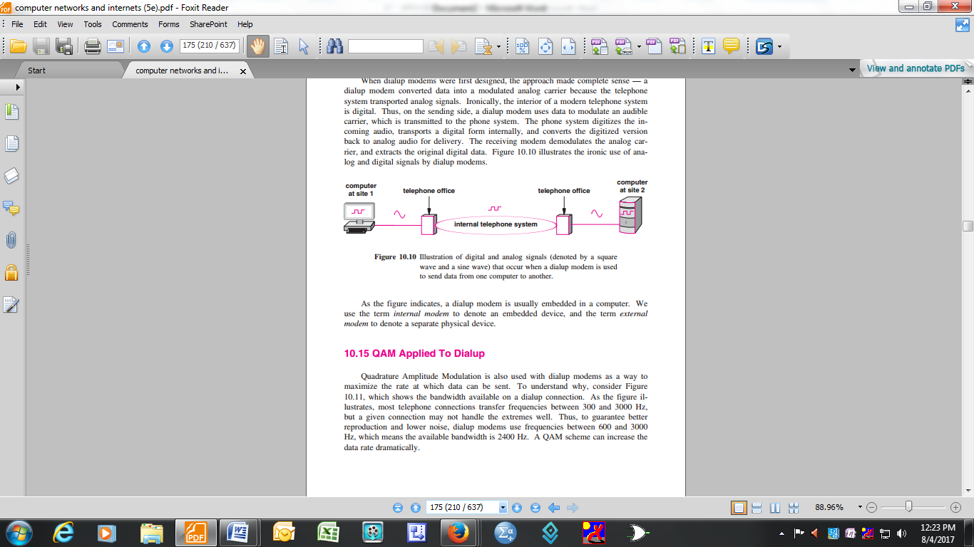
Conversion of digital to analog signals and vice versa using a dialup modem

Slide 7
Operation of a dial up modem
The internal modulator at site 1 converts the digital signals into analog form and are transmitted to the telephone office where they are converted back(demodulated) to digital signals in the internal telephone system.
From the telephone office the to the computer at site 2, the modulator converts the digital signals to analog and the demodulator in the computer at site 2 converts them to digital data bits.

Slide 8
QAM application to dialup
QAM is also used in with dialup modems in order to maximize the data transfer rates.
Most telephone systems use transfer frequencies that lie between 300 and 3000 Hz.
A given connection may not be able to handle the extremes very well.
In order to guarantee better reproduction and lower noise, dialup modems use frequencies between 600 and 3000Hz which gives a bandwidth of 2400 Hz. (See figure below)

Slide 9
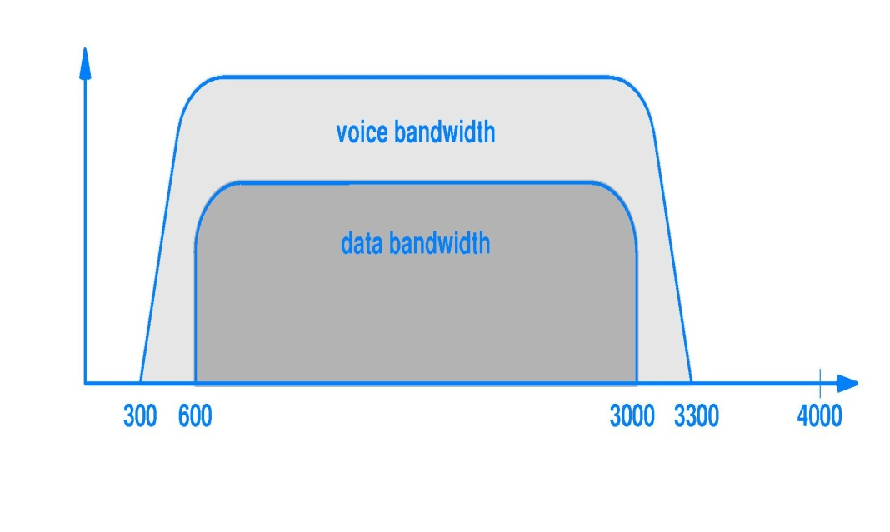
Voice and data bandwidth on a dialup telephone connection

Slide 10
The V.32 and V.32bis are some of the common dialup modems.
The V.32 dialup modem standard uses 32 combinations of amplitude shift and phase shift to achieve a full duplex data transfer rate of 9600 bits per second (bps). Figure below shows V.32 constellation diagram.

Slide 11
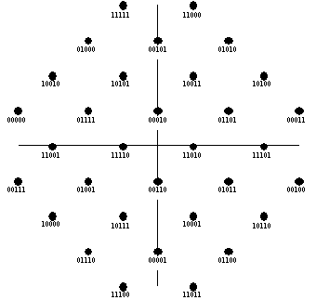
QAM V.32 constellation diagram.

Slide 12
The V.32bis dialup modem standard uses 128 combinations amplitude shift and phase shift and achieves a full duplex transfer rate of 14,400 bps.
The V.32bis modem can fall back to transfer rates of 12000, 9600, 7200 and 4800 bps.

Slide 13
MULTIPLEXING
Multiplexing is a technique of simultaneous transmission of multiple signals over single data link
A common type of multiplexing combines several low-speed signals for transmission over a single high-speed data link.
Without using multiplexing technique it was going to be very expensive to use telephone communication, mobile communication, data communication and satellite communication.

Slide 14
There are two most popular ways or techniques of multiplexing namely:
Frequency division multiplexing(FDM)
Time division multiplexing(TDM)
Time division multiplexing can be:
Synchronous TDM
Asynchronous TDM

Slide 15
Frequency Division Multiplexing
FDM -most popular with analogy transmission.
Technique divides the total bandwidth available to the system into non-overlapping frequency sub-bands for transmission over a single high speed communication channel.
FDM uses guard band frequencies to separate data transmissions. It is (FDM) used for band pass and not (baseband) data transmission

Slide 16
Band pass is an electronic device or circuit that allows signals between two specific frequencies to pass but does not allow other signals at other frequencies to pass.
So this device is used for filtering signals.

Slide 17
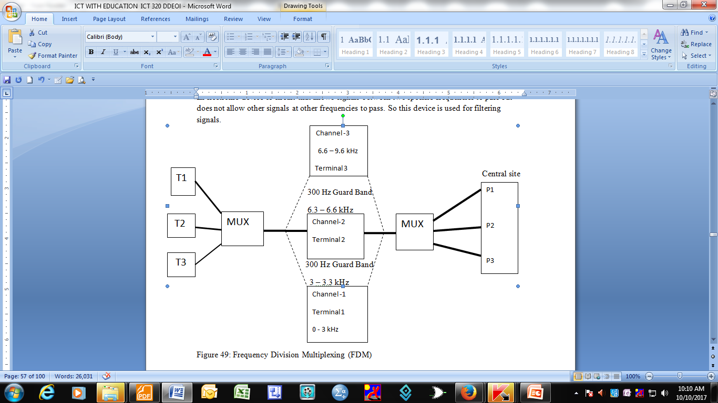

Slide 18
Explanation of the diagram
Consider three terminals, (T1, T2, T3) sharing a voice grade communications channel (0 – 3 kHz)
The three channels are allocated each a channel (frequency) to transmit data.
To avoid interference, 300 Hz guard bands separate each of the channels (see diagram above).
P1, P2 and P3 are ports in a computer at a central site.
Data from terminal 1 will be received or buffered at P1, from terminal 2 at P2 and from terminal 3 at P3. Figure below explains the basic concept of frequency division multiplexing.

Slide 19
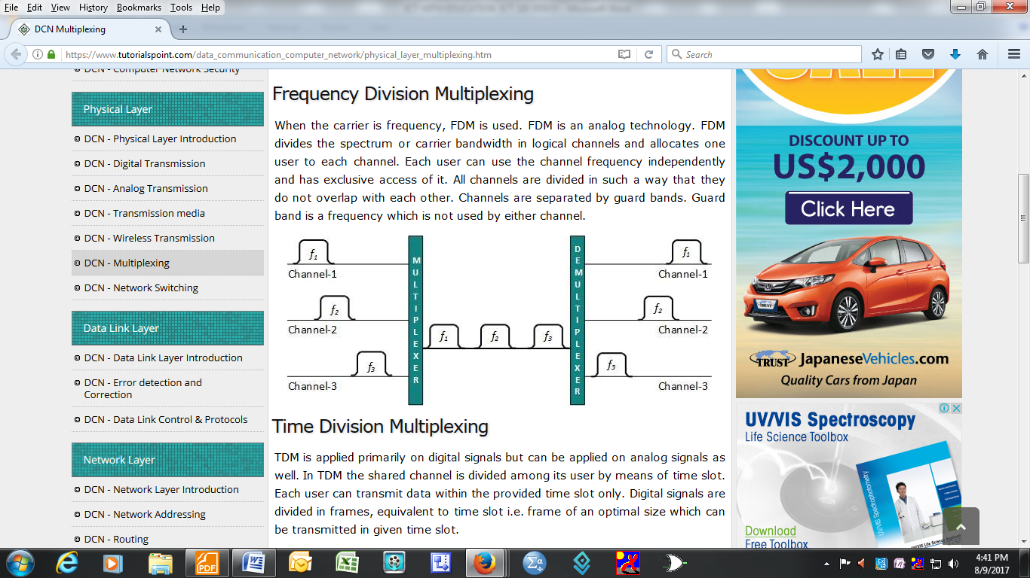
Basic concept of frequency division multiplexing.

Slide 20
Advantages of FDM
Some of the advantages of frequency division multiplexing are:
Users can send data simultaneously, so there is low latency
No dynamic coordination is needed
There is less noise

Slide 21
Disadvantages
Some of the disadvantages are:
FDM increases frequency bandwidth and frequency is a scarce resource
Separate frequency for each possible communication scenario is a waste of frequency resources
FDM is not flexible, at times one channel can be idle for long periods whilst the other is busy
When FDM is used there channel under utilisation, for example if applied to mobile communication, a call only takes a few minutes but for radio broadcasts that lasts 24 hours it is idle.

Slide 22
Time Division Multiplexing
TDM divides and allocates time slots to each channel in an alternating manner.
It combines several low fixed and predefined bit rate sources into a single high speed bit stream for transmission over a single digital communication channel. There are two types of TDM:
Synchronous TDM
Asynchronous TDM

Slide 23
Synchronous TDM allocates dedicated time slices to terminals.
So it periodically generates a frame that consists of a constant number of time slots with each slot having a constant length.
A flag is used for frame synchronization which is needed to differentiate one frame from the next.

Slide 24
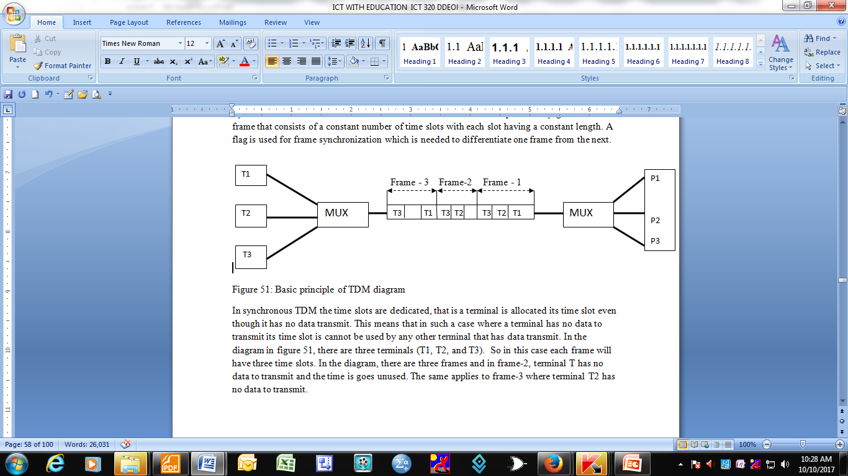
Basic principle of TDM diagram

Slide 25
In synchronous TDM the time slots are dedicated, i.e.a terminal is allocated its time slot even though it has no data transmit.
This means that in such a case where a terminal has no data to transmit its time slot is cannot be used by any other terminal that has data transmit.
In the diagram there are three terminals (T1, T2, and T3). So in this case each frame will have three time slots.
In frame-2, terminal T has no data to transmit and the time is goes unused.

Slide 26
The same applies to frame-3 where terminal T2 has no data to transmit.
Consider the Synchronous TDM diagram showing terminals, ports and data flow

Slide 27
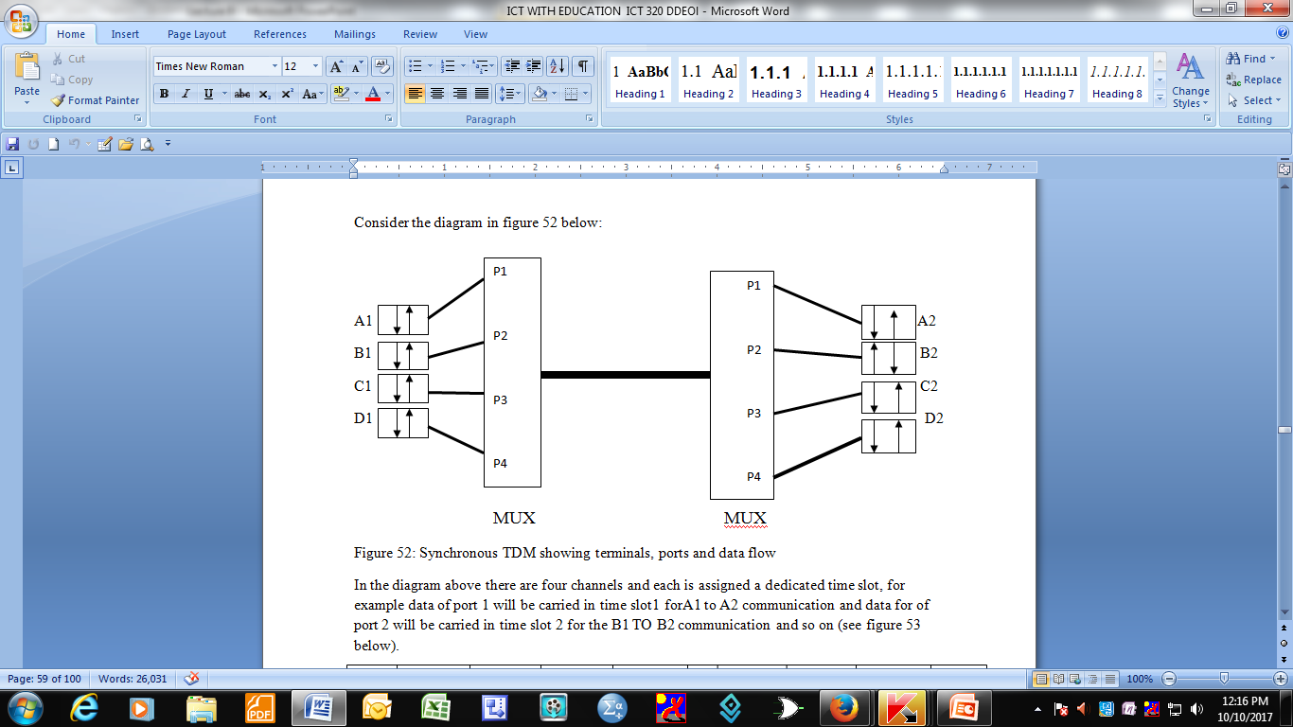

Slide 28
In the diagram above there are four channels and each is assigned a dedicated time slot, for example data of port 1 will be carried in time slot1 for A1 to A2 communication and data for of port 2 will be carried in time slot 2 for the B1 TO B2 communication and so on ( see diagram)

Slide 29
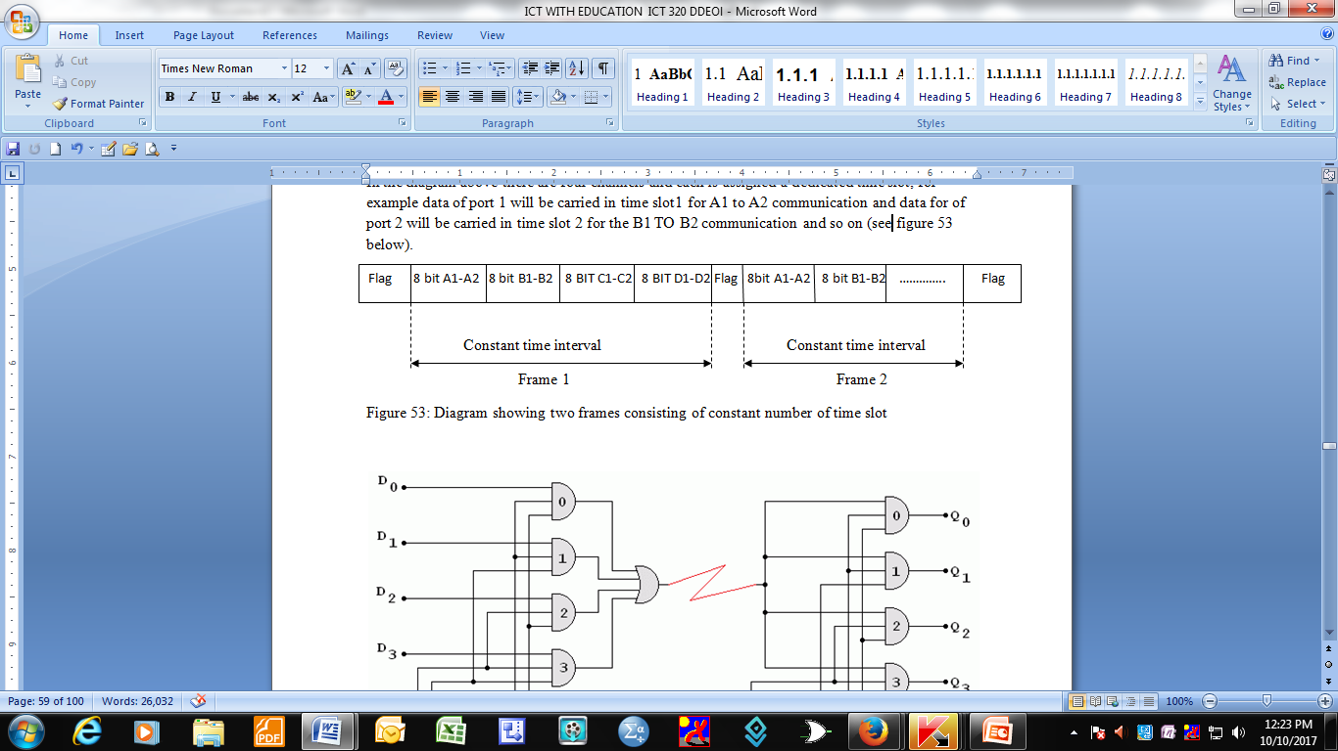
Diagram showing two frames consisting on constant number of time slots

Slide 30
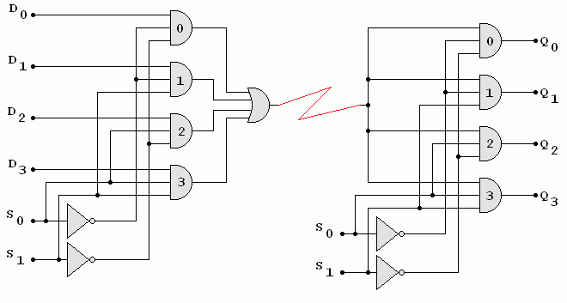
: Logic circuit illustrating synchronous TDM

Slide 31
Disadvantages of synchronous TDM
The major disadvantages of synchronous TDM are:
There is no full channel capacity utilisation.
Some of the slots go empty in certain frames as explained earlier (see figure below)

Slide 32
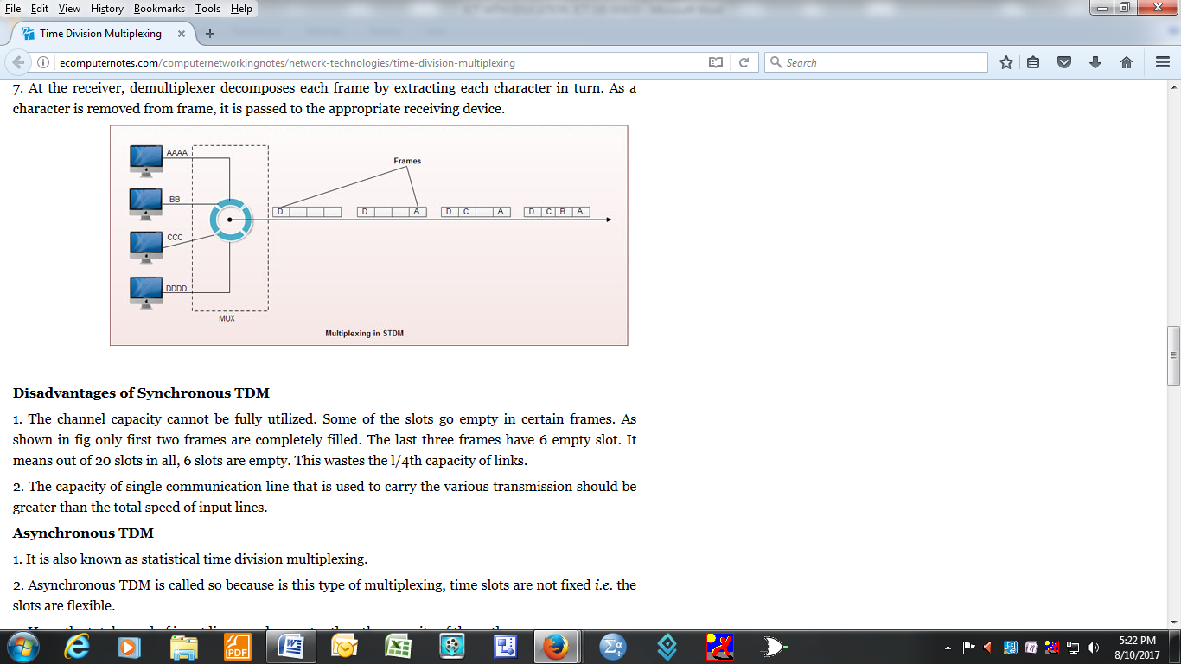
Synchronous TDM channel underutilisation

Slide 33
ASYNCHRONOUS TIME DIVISION MULTIPLEXING
Asynchronous TDM is also called Statistical time division multiplexing (STDM).
In this technique, the time slot is allocated dynamically.
This means there are no dedicated time slots.
A transmitting terminal’s time slot can be reallocated to another terminal (device), if the terminal in question has no data to transmit.

Slide 34
In Asynchronous TDM, the numbers of time slots in a frame are not necessarily equal to the number of terminals/devices (see figure below)

Slide 35
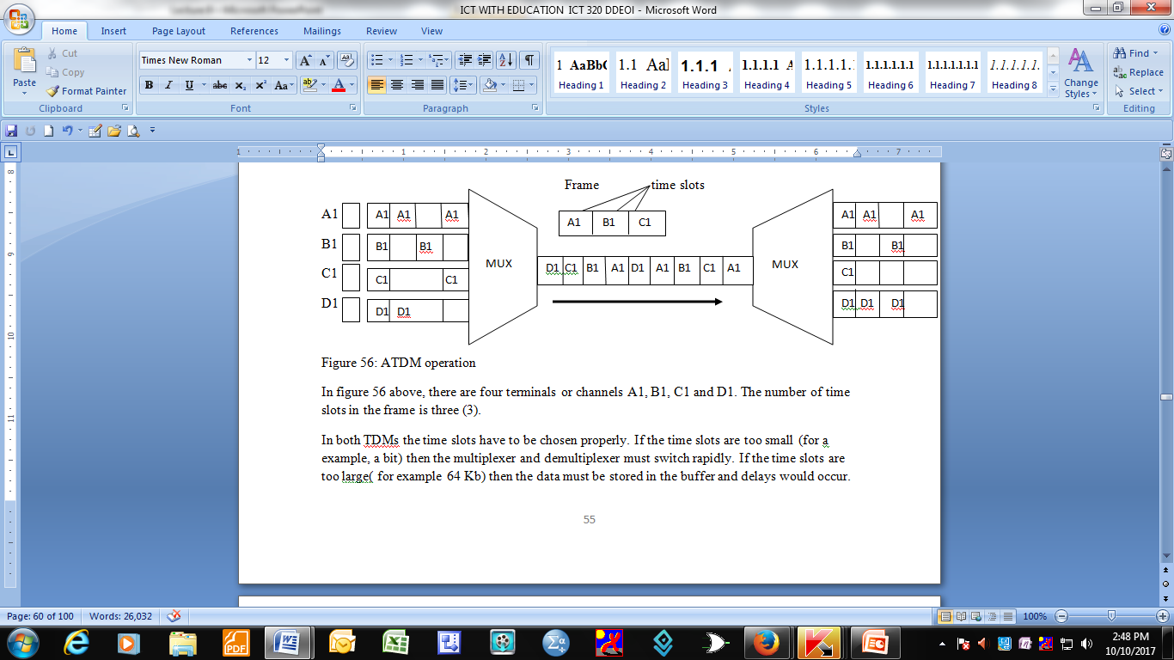
Asynchronous TDM

Slide 36
In the above diagram there are four terminals or channels A1, B1, C1 and D1.
The number of time slots in the frame is three (3).
In both TDMs the time slots have to be chosen properly.
If the time slots are too small (for a example, a bit) then the multiplexer and demultiplexer must switch rapidly..

Slide 37
If the time slots are too large( for example 64 Kb) then the data must be stored in the buffer and delays would occur
The T1 TDM system for the telephone networks use 193 bit frame where each frame is 24 8- bit slots and a 1-bit slot in each frame for signalling. The T1 bit rate r_{b} = 1.544 Mb/sec

Slide 38
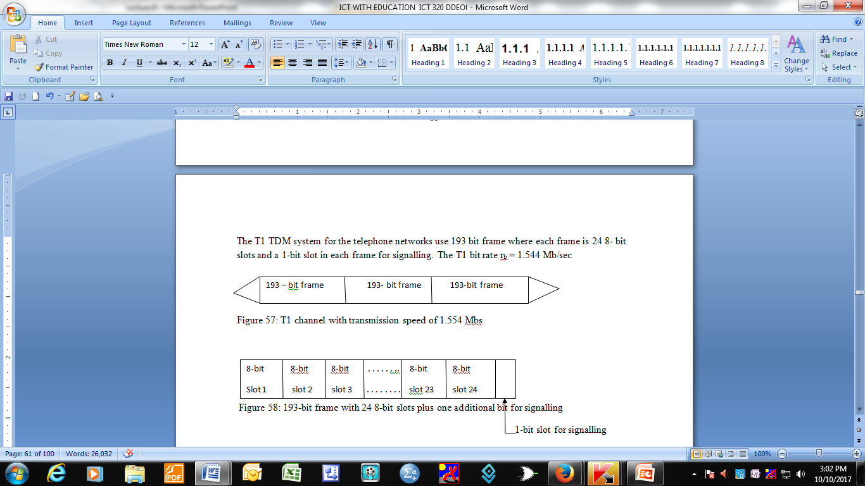

Slide 39
The duration for each frame Tƒ = 193b/1.544Mbs ≈125ϻsec or 8 samples/sec. In the above case all the data sources have the same data transfer rate.
If the data sources have different rates, then a multiplexer scheme must reconcile the disparate rates. Consider figure 59 below:

Slide 40
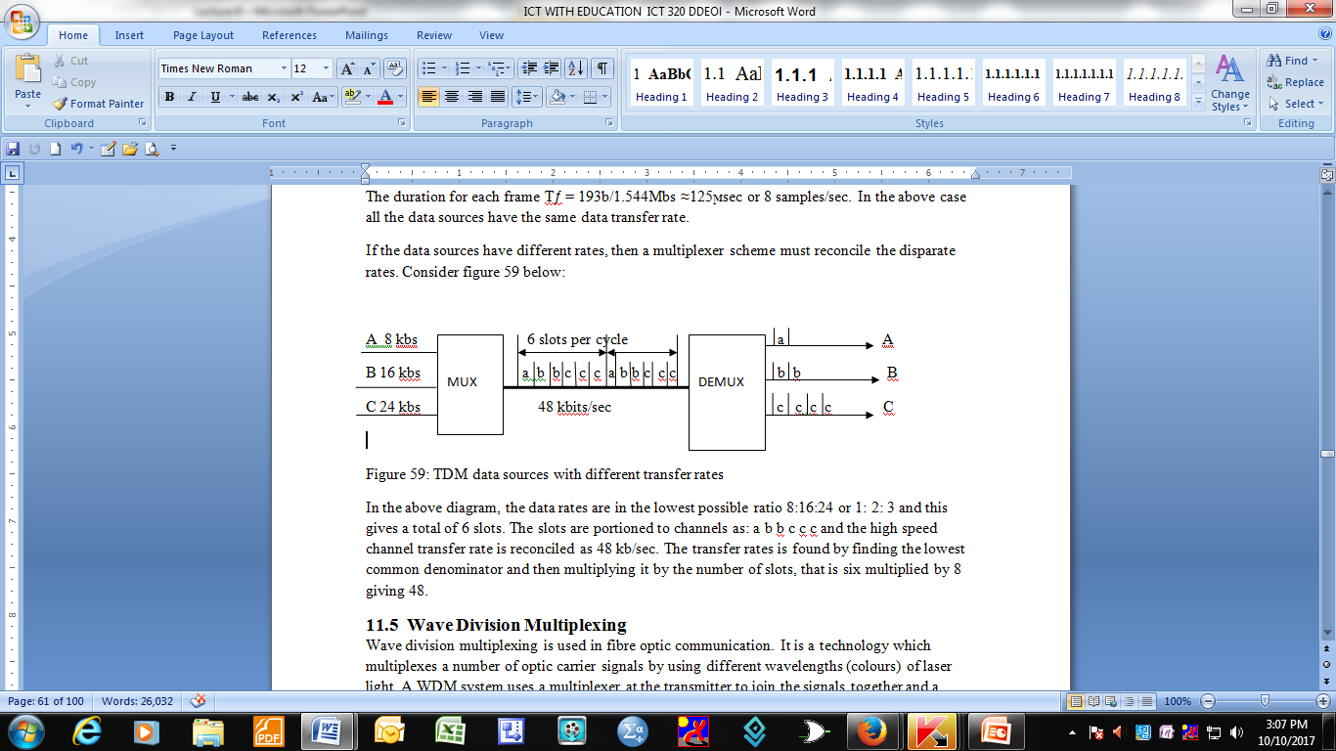
TDM data sources with different TDM data sources with different transfer rates

